Slide 1
SONG RELEASE YEAR PREDICTION
CMPE 255 PROJECT PRESENTATION
Presented by:
Charanveer Singh
Hongjin Cheng
Moxank Prakashbhai Patel
Xinyu He
Group No: 10

Slide 2
Dataset Description
Name: Year Prediction Dataset (subset of MillionSongDataset)
Link: https://archive.ics.uci.edu/ml/datasets/YearPredictionMSD
Western and Commercial Tracks from 1922 to 2011
Attributes: 90
12 timbre average
78 timbre covariance
Instances: 515345

Slide 3
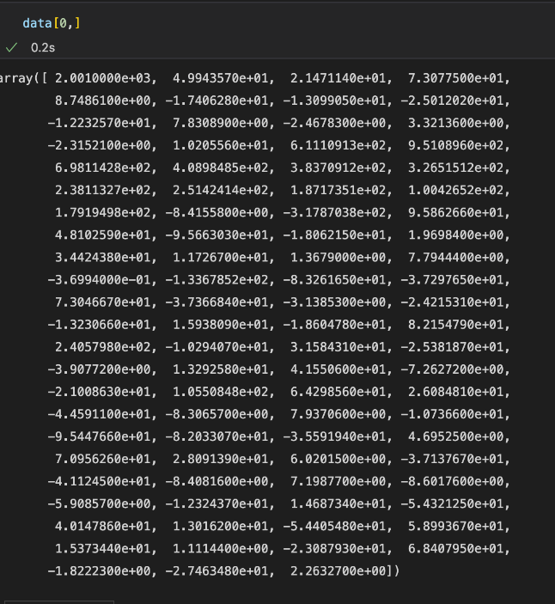
Dataset Description
Predictive Method
use some variable (timbre) to predict unknown variable (song year)
The first column is the label of the record. The next 12 are the timbre average and remaining are timbre covariance.
Figure 1: Dataset Sample

Slide 4
Part One:Data Pre-Processing
1.1 Feature Extraction
1.2 Feature Selection
1.3 Data Visualization
1.4 PCA (Dimensionality Reduction)
1.5 Splitting data into training and testing

Slide 5
1.1 Feature Extraction
Data Preparation is the process of transforming raw data into an understandable format
NULL/Missing values
Drop Duplicate Values
Detecting Outliers
Data Organization for easy analysis

Slide 6
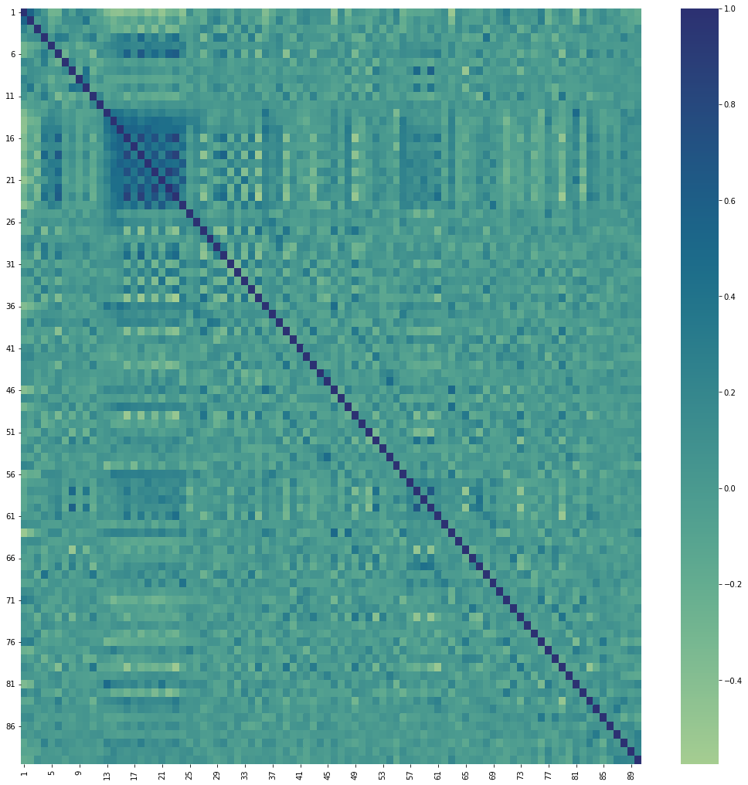
1.2 Feature Subset Selection
When creating a predictive model. Feature selection is the process of minimizing the number of input variables. It is preferable to limit the number of input variables in order to reduce modeling computational cost and , in some cases, increase the model performance.
Figure 2: Correlation Heatmap

Slide 7
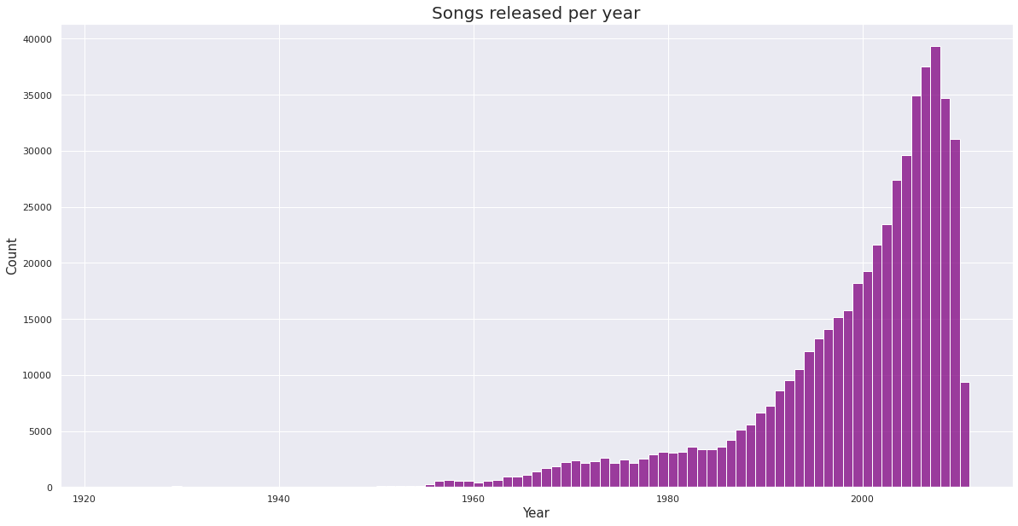
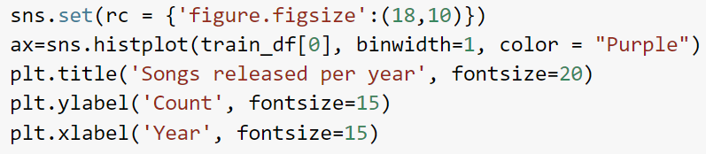
1.3 Data Visualization
graphical representation of information and data to understand trends, outliers, and patterns in dataset better.
Figure 3: Dataset Visualization

Slide 8
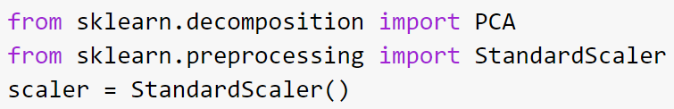
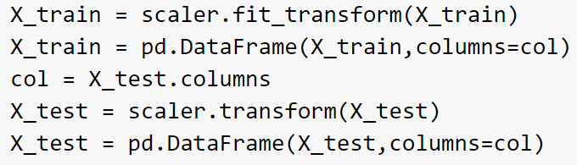
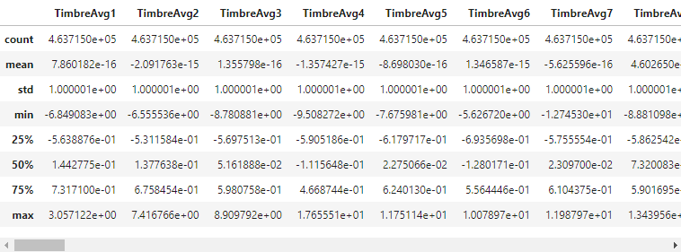
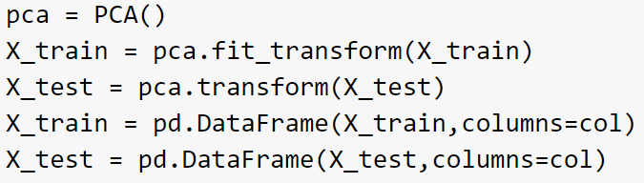
1.4 PCA (Dimensionality Reduction)
interested in the components that maximize the variance
Figure 4: PCA

Slide 9

1.4 PCA (Dimensionality Reduction)
We only kept transformed features that accounted for 95% of the variance
Figure 5: Scatter plot of transformed data

Slide 10
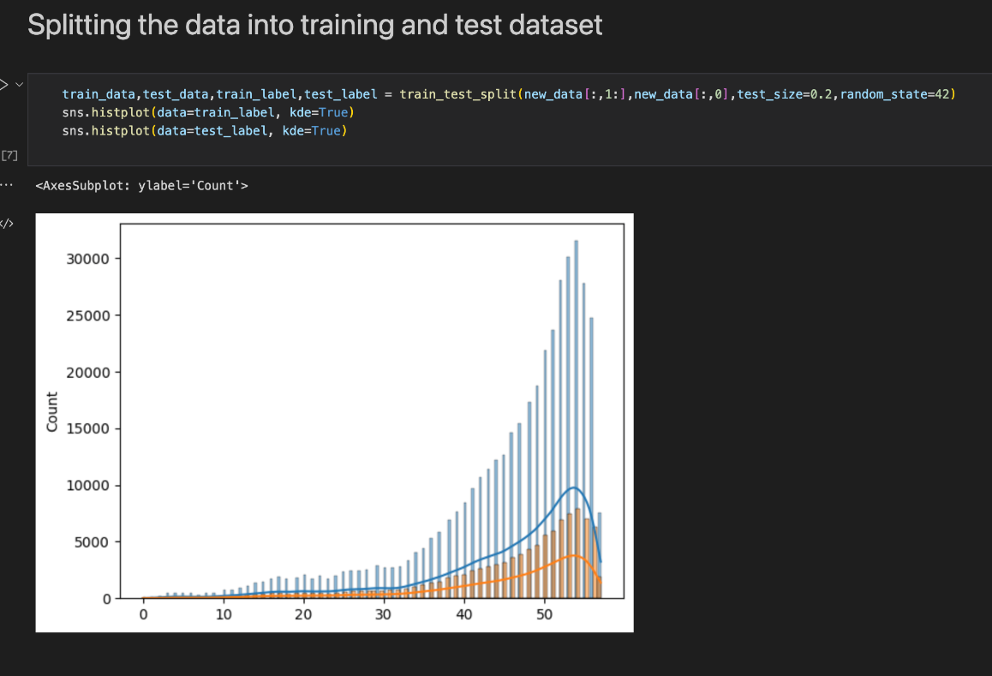
1.5 Training/Testing Split
Each of the features takes a wide range of different values and distributions.
Figure 6: Train/Test Split

Slide 11
Part Two:Model and Model Performance
2.1 Logistic Regression
2.2 Decision Tree Classifier
2.3 Random Forest Classifier
2.4 Neural Network Model
2.5 Model Performance

Slide 12
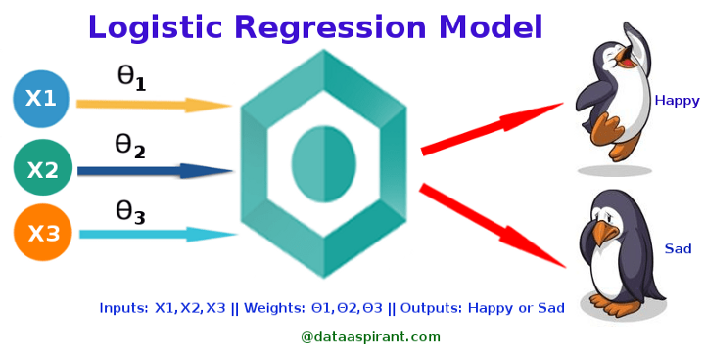
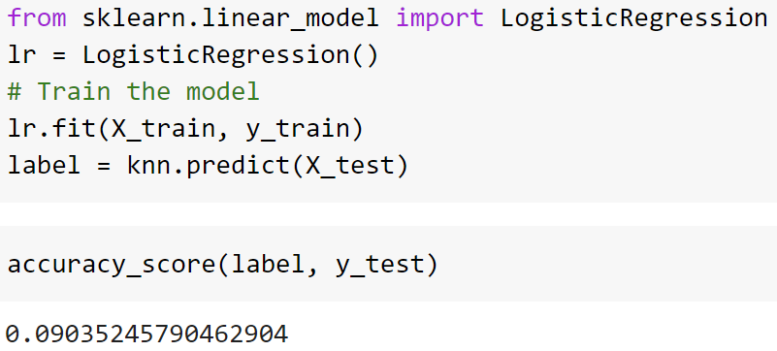
2.1 Logistic Regression
Used for prediction/classification
Types:
Binary
Multinomial
Ordinal
Figure 7: Logistic Regression Model

Slide 13
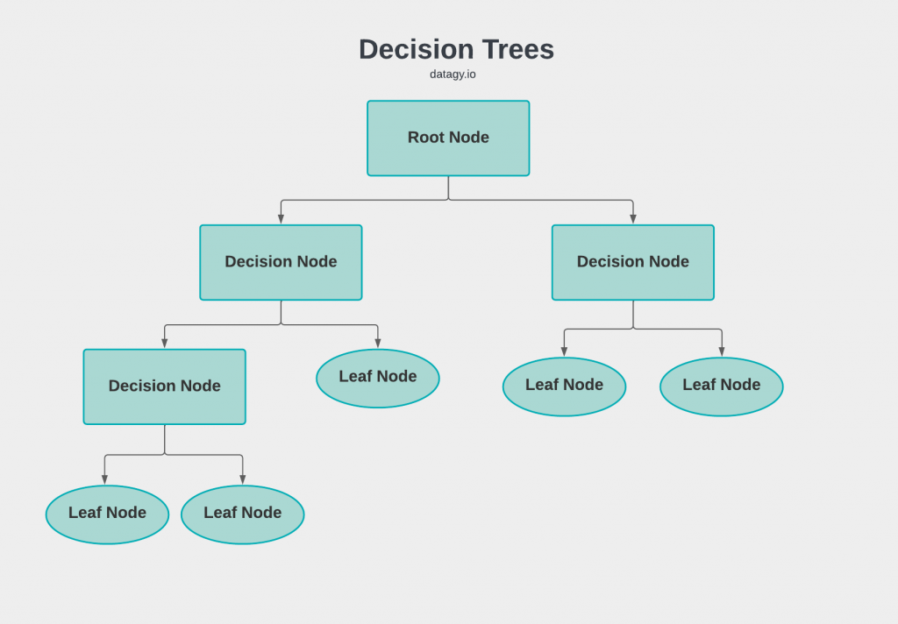
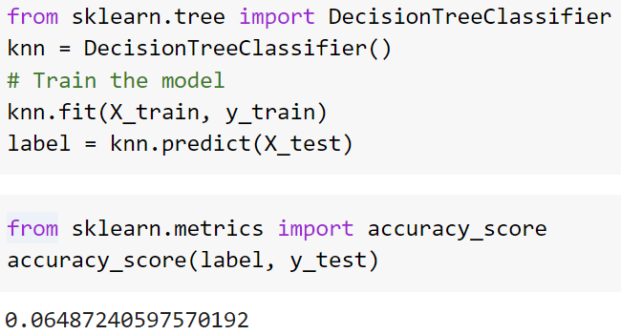
2.2 Decision Tree Classifier
Supervised ML Model
Used for both classification/Regression
Figure 8: Decision Tree Model

Slide 14
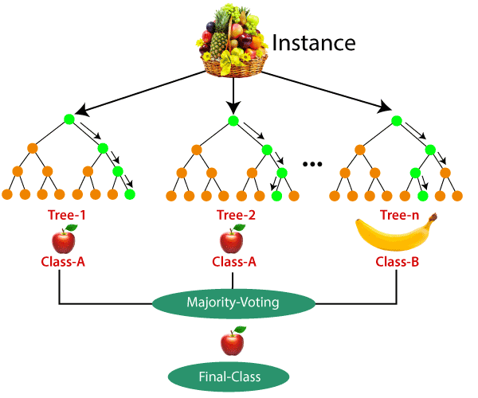
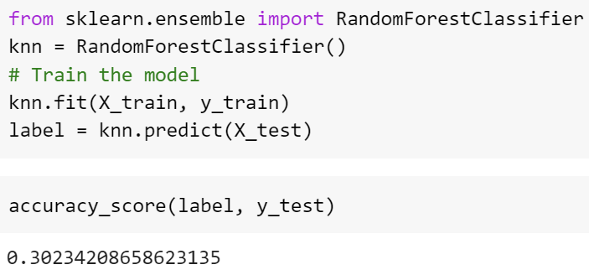
2.3 Random Forest Classifier
Supervised ML Model
Used for both classification/Regression
Creates a set of decision trees from randomly selected subset of training set
Figure 9: Random Forest Model

Slide 15
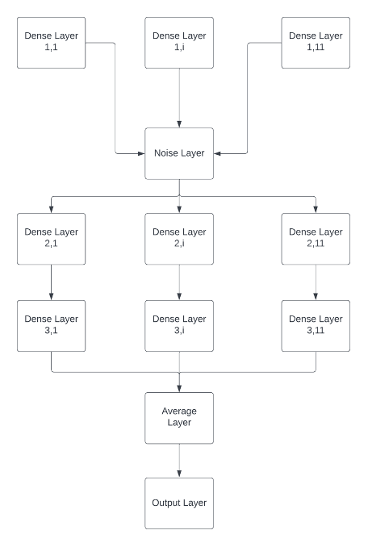
2.4 Neutral Network Model
Figure 10: Neural Network Model

Slide 16
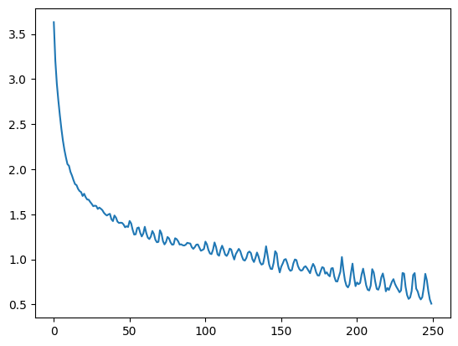
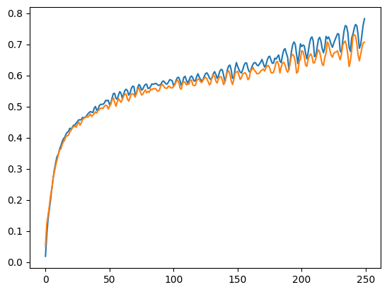
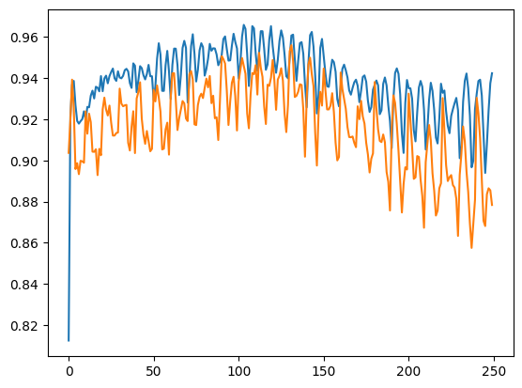
2.4 Neutral Network Performance
Precision of Model: 94%, Recall: 88%
Figure 11: Loss of the model during the epochs
Figure 12: Precision vs Precision of validation dataset of model during the training
Figure 13: Recall vs Validation recall of model during the training

Slide 17
2.4 Model Performance
Model | Accuracy Score
Logistic Regression | 10%
Random Forest | 30%
Decision Tree | 7%
Neural Network | 88%
Table 1: Model Performance

Slide 18
Github Link

Slide 19
References
https://towardsdatascience.com/logistic-regression-detailed-overview-46c4da4303bc
https://datagy.io/sklearn-decision-tree-classifier/
https://archive.ics.uci.edu/ml/datasets/YearPredictionMSD
https://www.geeksforgeeks.org/random-forest-classifier-using-scikit-learn/
https://towardsdatascience.com/principal-component-analysis-pca-explained-visually-with-zero-math-1cbf392b9e7d
https://www.wgu.edu/blog/neural-networks-deep-learning-explained2003.html

Slide 20
Thank You
Questions?

